Slide 1
Latest and Greatest Free and Low Cost Assistive Technology for Everyone
Rachel Kruzel – Assistive Technology & Accommodations Specialist
Augsburg University
March 2nd, 2018

Slide 2
Today’s Agenda:
Things to Remember When Working with Assistive Technology
Latest, Greatest and Free and Low Cost Apps and Programs
Resources and Questions

Slide 3
Always Remember: S-E-T-T
S – Student
E – Environment
T – Task
T – Tools
Created by Joy Zabala Ed. D.

Slide 4
Definitions
App: a piece of software used to do a particular task; for example, an app from the App store for your iPhone
Browser Extension: a piece of software that lets your web browser do more than it could without it; for example, a Chrome Extension
Notes:
Many apps, programs and support tools out there
Constantly changing, updating, new ones being added
Not all programs and apps will be shown today
With unlimited resources, it can be overwhelming to decide what’s the best tool is for the task

Slide 5
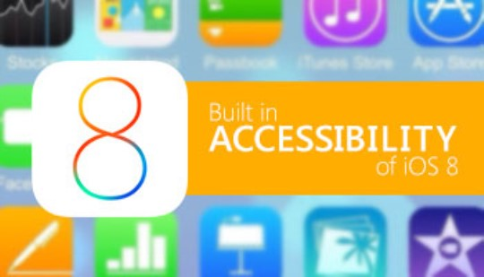
Definitions
Add-On/Plug-In: a piece of software that increase what you can do in a web browser
Built-In: a program or piece of software that comes with the device you bought

Slide 6
Free and Low Cost Compilation Resource
Augsburg University has compiled a resource list of Free and Low Cost Assistive Technology
Tools broken down by category with information on Features, Platform(s), and Cost
Always looking to add more tools to list
All tools talked about today are listed in this resource
http://www.augsburg.edu/class/groves/assistive-technology/

Slide 7
Free and Low Cost Tools
Reading & Literacy Support
Writing Support (Dictation)
Notetaking
Math
Emotion Regulation, Stress Management, & Relaxation
Hearing and Auditory Support

Slide 8
Areas Not Covered Today
Built-In Accessibility
Mind Mapping & Brainstorming
Organization Support
Time Management
Study Skills
Research Skills
Task/Time Management
Vision
Communication

Slide 9
Tools Covered Today
Notes:
National Institutions of Health: Estimates between 6 and 17% of school-aged children have some form of dyslexia – not all have been identified by their school : http://www.edweek.org/tm/articles/2017/05/24/unidentified-dyslexia-takes-toll.html?cmp=eml-enl-tu-news1

Slide 10
Reading & Literacy Support
Mercury Reader – Tool to clear webpages of clutter for easier reading
Chrome Extension: https://mercury.postlight.com/reader/
Microsoft Office Suite Tools – see next slides
Notes:
Line/Word Spacing
2012 Research study by Zorzi showed 50% fewer reading errors when people with dyslexia increase spacing
To increase speed, research published by Schneps showed a 27% increase in reading speed when using shortened line length
Syllables – breaking words apart into syllables can increase reading comprehension by 10% (Yu-Chi Tai in a study supported my Microsoft)

Slide 11
Reading & Literacy Support in Microsoft Word & OneNote
Spacing - Increases space between letters, words, and lines of text
OneNote on Windows PC, One Note Online, Word on Windows PC, Word Online
Comprehension - Highlights dependent clauses within sentences
Microsoft OneNote on Windows PC
Parts of Speech - Shows verbs, nouns, and adjectives in different colors
Microsoft OneNote on Windows PC and Online, Word Online
High Contrast - Increased color contrast for people with visual disabilities
https://support.office.com/en-us/article/Learning-Tools-to-improve-reading-and-writing-skills-735fc6ea-21eb-401a-9293-4a481ef7e482?ui=en-US&rs=en-US&ad=US
Notes:
Line/Word Spacing
2012 Research study by Zorzi showed 50% fewer reading errors when people with dyslexia increase spacing
To increase speed, research published by Schneps showed a 27% increase in reading speed when using shortened line length
Syllables – breaking words apart into syllables can increase reading comprehension by 10% (Yu-Chi Tai in a study supported my Microsoft)

Slide 12
Reading & Literacy Support in Microsoft Word & OneNote
Immersive Reader - Recognizes text from images and files
OneNote on Windows PC, OneNote Online, Word Online
Read Mode aka Focus Mode - Reduces Line Length
Word on Windows PC
Read Aloud - Highlights words while reading them out loud
OneNote on Windows PC, OneNote Online, Word o Windows PC, Word Online
Syllables - Separates words into syllables
OneNote on Windows PC, One Note Online, Word on Windows PC, Word Online
https://support.office.com/en-us/article/Learning-Tools-to-improve-reading-and-writing-skills-735fc6ea-21eb-401a-9293-4a481ef7e482?ui=en-US&rs=en-US&ad=US
Notes:
Line/Word Spacing
2012 Research study by Zorzi showed 50% fewer reading errors when people with dyslexia increase spacing
To increase speed, research published by Schneps showed a 27% increase in reading speed when using shortened line length
Syllables – breaking words apart into syllables can increase reading comprehension by 10% (Yu-Chi Tai in a study supported my Microsoft)

Slide 13
Writing Support
Voice Recognition in Google Docs – Dictation tool to speak text into a Google Document
Built into Google Docs: https://goo.gl/OItJ7x
Dictate through Phone into Google Docs
Dicate – Microsoft Office 365 – Built-In Speech-to-Text within Office 365
More information: dictate.ms
Tab Scissors/Tab Glue: Split two internet browser windows apart and then glue them back together to split screen your work
Chrome Extensions: https://goo.gl/RUrZwI & https://goo.gl/1fchGv
Cold Turkey Writer – block out distractions and write in a clean workspace on your computer; program won’t close until a certain number of words have been written or minutes have passed
Windows; Mac: https://getcoldturkey.com/writer/

Slide 14
Notetaking Support
Rocketbook – Notebook with ability to upload notes with iOS app to Google Docs, Dropbox , etc.
Three Noetbook Versions: One, Wave, & Everlast (Coloring for kiddos)
iOS app and standalone tool: https://getrocketbook.com/
AudioNote – Take notes on your computer or tablet and link the typed notes up with the recorded audio
iOS – Windows; Mac; iPad; Android: http://luminantsoftware.com/iphone/audionote.html
Sonocent Recorder App – Free app to record lecture with ability to color code lecture; Full version with additional features
iOS: https://www.sonocent.com/en/ios-recorder
Companion Program to Sonocent Audio Recorder…
Audio Notetaker version 5 – Windows & iOS: https://www.sonocent.com/en/audio-notetaker

Slide 15
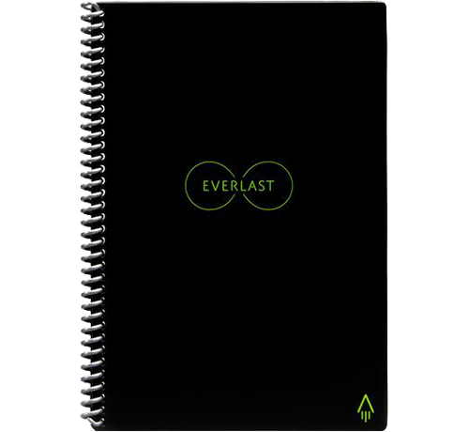
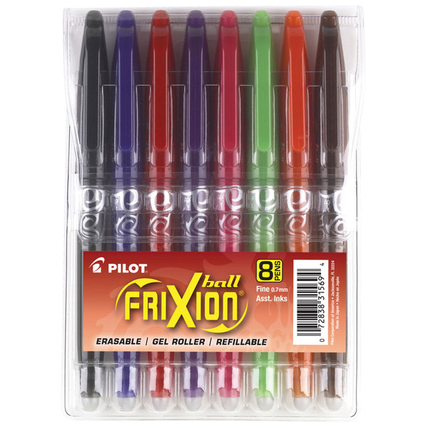
Rocketbook

Slide 16
Math Support
EquatIO – https://www.texthelp.com/en-us/products/equatio/
For Google: Add equations, formulas, and more into Google Docs, Forms, Sheets, Slides, and Drawings
For Windows and Mac: Add equations and mathematical expressions into Word
Mathspace: Web-based app independent and collaboration on math problems; mix equations, text, and freehand drawings: https://equatio.texthelp.com/

Slide 17
Emotion Regulation, Stress Management, & Relaxation Support
Pacifica – Improve your mental wellness with a variety of tools built into the app
iOS, Android, Web: http://www.thinkpacifica.com/
Momentum – personal internet dashboard to help provide inspiration and focus, remove distraction, and help manage tasks
Chrome Extension: https://momentumdash.com/

Slide 18
Hearing & Auditory Support
Ava – on the fly captioning in real time 24/7 using the app
iOS, Android: https://www.ava.me/

Slide 19
Additional Tools

Slide 20
Reading, & Literacy Support
Notes:
National Institutions of Health: Estimates between 6 and 17% of school-aged children have some form of dyslexia – not all have been identified by their school : http://www.edweek.org/tm/articles/2017/05/24/unidentified-dyslexia-takes-toll.html?cmp=eml-enl-tu-news1

Slide 21
Other Tools …
Windows, Mac, Apps:
Kami – PDF and document annotation tool that works in Google Drive and Google Classroom
https://web.kamihq.com/web/viewer.html or https://goo.gl/h3Zaqo
Voice Dream Reader – Text-to-Speech app with annotation capability
iOS, Android: http://www.voicedream.com/
Beeline Reader – Polychromatic text reader; helps eyes track from word-to-word and line-to-line
Web Resource, iOS App: http://www.beelinereader.com/
ReadMe! – Text-to-Speech app with Beeline Reader Capability
iPhone, iOS, Android: https://www.readmei.com/
Balabolka – Text-to-Speech reader for Windows OS with mp3 and Spritz reader capability
Windows: http://www.cross-plus-a.com/balabolka.htm
Claro ScanPen – Take photo of printed text and have it read aloud with this app
iOS; Android: https://claro-apps.com/claro-scanpen
Claro PDF Pro – Text-to-Speech app with annotation tools
iOS; Android: https://claro-apps.com/claropdf/

Slide 22
Other Tools …
Web Resources and Chrome Extensions:
SpeakIt! – Text-to-Speech for web pages
Chrome Extension: https://goo.gl/7M00Qy
Spritz – Tachistoscope tool which flashes one word on the screen at a time for reading
Web Resource: http://www.spritzinc.com/
Readsy – Tachistoscope tool which flashes one word on the screen at a time for reading
Web Resource: http://www.readsy.co/
Rewordify – Website which simplifies reading passages with easier vocabulary words
Web Resource: https://rewordify.com/

Slide 23
Other Tools …
Snap & Read – Text-to-Speech reader compatible with variety of file formats
iPad; Chrome Extension: http://donjohnston.com/snap-read/
GhostReader – Text-to-Speech reader similar to Balabolka for Mac OS
Mac OS: http://www.convenienceware.com/ghostreader
iReadWrite – Text-to-Speech app with dictionary support
iOS 6.0 or later: https://itunes.apple.com/us/app/ireadwrite/id600843386?mt=8
OpenDyslexie – Font for increased readability for people with dyslexia
Mac; Windows; iOS; Android; Chrome, Safari, Opera: https://opendyslexic.org/
Natural Reader – Text-to-Speech reader with voice customization
Windows; Mac; Online Resource – http://www.naturalreaders.com
Read&Write – Text-to-Speech app with dictionary support
iPad, Android: http://www.texthelp.com/north-america/rwtablets
Read & Write Chrome Extension – Similar tools to Read & Write Desktop and Google
Chrome Extension: https://www.texthelp.com/en-us/products/read-write/read-write-for-google/
Spreed – Tachistoscope tool similar to Spritz or Readsy
Chrome Extension: http://www.spreeder.com/

Slide 24
Writing Support
Notes:
Writing support tools that help get the ideas out, help to form the paper and ideas – don’t really exist
Get questions on this all the time, mindmapping – yes, dictation – yes, grammar support – yes but actually formulating the ideas - not really

Slide 25
Other Tools …
Voice Dream Writer – Speak As I Type, Spell Checker, Word Finder, and Outline Format Ability
iPad, iPhone: http://www.voicedream.com/writer/
Ginger – Spelling and Grammar checker with additional premium features
Windows, Mac, Android, iOS, Web Resource: http://www.gingersoftware.com/
Grammarly – Tool to correct spelling, grammar, and poor vocabulary use
Chrome Extension: https://www.grammarly.com/
Ghotit – Online contextual and phonetic spelling and grammar checker
Web Resource: http://www.ghotit.com/
Voice Dream Writer – Speak As I Type, Spell Checker, Word Finder, and Outline Format Ability
iPad, iPhone: http://www.voicedream.com/writer/
Ginger – Spelling and Grammar checker with additional premium features
Windows, Mac, Android, iOS, Web Resource: http://www.gingersoftware.com/
Grammarly – Tool to correct spelling, grammar, and poor vocabulary use
Chrome Extension: https://www.grammarly.com/
Ghotit – Online contextual and phonetic spelling and grammar checker
Web Resource: http://www.ghotit.com/

Slide 26
Other Tools …
Co:Writer – Word prediction app with ability to have words read aloud
iOS: http://donjohnston.com/cowriterapp/#.U0g21PldV8E
Spell Better Word Prediction Tool for Writing with Read Aloud capabilities ***
iOS: http://www.spellbetterapp.com/
Read&Write – Word Prediction, Speak As I Type, and Spell Checker
iPad, Android: http://www.texthelp.com/north-america/rwtablets
iReadWrite – Word Prediction, Phonetic Spell Checker, and Homophone Checker
iOS 6.0 or later: https://itunes.apple.com/us/app/ireadwrite/id600843386?mt=8
iWordQ – Word prediction, abbreviation expansion and speech feedback
iPad: http://www.goqsoftware.com/en/writing-products/iwordq/
**This app can be used as a quick AAC or Communication device tool too

Slide 27
Dictation, Speech-to-Text, & Speech Recognition

Slide 28
Other Tools …
Dictate – Speech recognition tool in OneNote
Microsoft OneNote: https://support.microsoft.com/en-us/help/4013144/microsoft-education-transform-speech-to-text-in-learning-tools
Voice Note II – Dictation tool for use in the Chrome Browser
Chrome App: https://goo.gl/uXrdje
Dragon Dictation App – Record up to one minute of dictation with this iOS app
iOS: http://www.nuance.com/for-individuals/mobile-applications/dragon-dictation/index.htm
Speech Recognition – Built into Windows Operating Systems (mentioned on list of built-in programs)
Windows: https://support.microsoft.com/en-us/help/14213/windows-how-to-use-speech-recognition

Slide 29
Mind Mapping & Brainstorming Support

Slide 30
Other Tools …
Inspiration – Mind mapping, graphic organization, and outlining tool
Windows; Mac OS: http://www.inspiration.com/
Mind Meister – Mind mapping tool for cross platform use
Web Resource, iOS, Android: http://www.mindmeister.com/
Idea Sketch – Mind mapping for cross platform
Windows, Mac, iOS, Windows Phone: http://www.nosleep.net/
Inspiration Maps – App version of Inspiration
iPad: http://www.inspiration.com/inspmaps
Popplet – Mind mapping for iOS or web
iOS; Web Resource: http://popplet.com/

Slide 31
Notetaking Support

Slide 32
Other Tools …
Noteability – iOS app with ability to type, write, annotate, insert images, and record lectures
iOS: http://www.gingerlabs.com/
One Note – Notetaking program with typing, insert images, recording, and other features
iOS, Mac, Windows, Android, Web: https://www.onenote.com/
SoundNote – similar to Notetability with the ability to type notes and record audio
iOS – Mac, iPad: http://soundnote.com/
MicNotes – Voice Recorder and Notepad
Windows; Mac OS; Chrome; Linu; Android: https://www.micnote.audio/
AccessNote – Notetaking tool created by American Federation for the Blind
iPad, iPhone, iPod Touch; Android: http://goo.gl/bozjm7

Slide 33
Math Support

Slide 34
Other Tools…
Insert Equation – Enter equations and math symbols into Microsoft Word
Microsoft Word: https://support.office.com/en-us/article/Write-insert-or-change-an-equation-1d01cabc-ceb1-458d-bc70-7f9737722702

Slide 35
Organization & Task Management

Slide 36
Other Tools …
Extensity – Chrome Extension to organize Chrome Extensions
Chrome Extension: http://sergiokas.github.io/Extensity/
My Study Life – Cross platform tool to organize school work
iPhone; Android; Windows 8; Windows Phone; Online Resource - https://www.mystudylife.com/
Todoist – Cross platform tool to organize work and other tasks
Windows; Mac; iPad, iPhone, iPod Touch; Android; Web Resource: https://en.todoist.com/
Google Keep/GoKeep – Digital post-it note bulletin board
iPhone; iPad, iPod Touch; Android; Online Resource: http://keep.google.com/
Cold Turkey – Website blocking tool
Windows: http://getcoldturkey.com/
Tile – Device attached to items to help track your belongings using the app
Standalone Device, iPhone, iPad; Android: https://www.thetileapp.com/
Priority Matrix – Templates for prioritizing work and tasks
Windows, Mac; iOS, Android: http://www.appfluence.com/
Remember the Milk – Cross platform organization and reminder tool
Web Resource, iOS, Android: http://www.rememberthemilk.com/
Self Control – Website blocking tool similar to Cold Turkey but for Mac OS
Mac: https://selfcontrolapp.com/

Slide 37
Time Management and Distraction Free Support

Slide 38
Other Tools …
Pomodoro Timer – Pomodoro Philosophy timer – 25 minutes on; 5 minute break**
iPad, iPhone, iPod Touch: https://goo.gl/Btcdzy
Strict Workflow – Pomodoro Timer for Chrome which blocks websites
Chrome Extension: https://goo.gl/RE99hl
focus booster – Pomodoro Timer tracker
Mac, PC, Online Resource: https://www.focusboosterapp.com/
TimeTimer – Visual Timer
Standalone, iPad: http://www.timetimer.com/
Guided Access – Built-in iOS tool which restricts access to only chosen program on device
iOS: https://support.apple.com/en-us/HT202612
30/30 – Timer with task management capability
: http://3030.binaryhammer.com/
** Multiple other apps and programs that focus on the Pomodoro Technique that can be found by Googling Pomodoro Timer

Slide 39
Study Skills Support

Slide 40
Other Tools …
Quizlet – Robust flashcard study tool for cross platform use with games and interactive learning
iOS: iPad, iPhone, iPod Touch; Android; Online Resource: http://quizlet.com/
Study Blue – Cross platform flashcard tool
iOS: iPad, iPhone, iPod Touch; Android; Online Resource: http://www.studyblue.com/
iAnnotate – Annotation and markup app
iOS; Android – http://www.branchfire.com/iannotate/

Slide 41
Research Support

Slide 42
Other Tools …
Research Project Calculator – Calculate the timeline of a large project or research paper
Web Resource: https://rpc.elm4you.org/
Son of Citation Machine – Bibliography and citation tool
Web Resource: http://citationmachine.net/index2.php
Scrible – Annotation tool
iOS: iPad; Online Resource: http://www.scrible.com
EasyBib – Bibliography and citation tool
Web Resource: http://www.easybib.com/

Slide 43
Emotion Regulation, Stress Management, & Relaxation Support
Notes:
Learning Disabilities used to be the highest number of students who access resources from the Disability Resource Office in Higher Ed; it is now been surpassed by students with Mental Health Disabilities
Many students don’t have the skills coming into college to cope with negative situations, adversities, etc.

Slide 44
Other Tools …
Pacifica – Manage stress and anxiety daily based on Cognitive Behavioral Therapy and Meditation with this app created by psychologists
iOS; Android; Web: https://www.thinkpacifica.com/
Unstuck – Put words to your feelings with this tool as well as receive support and tips
iOS, Android, Web Resource https://www.unstuck.com/
Breathing Zone – Breathing regulation app
iOS: https://goo.gl/3GjA24
Calm - App for mindfulness, meditation, breathing and sleep
iOS – iPad, iPhone, iPod Touch; Android; Web Resource: https://www.calm.com/
Fidget Cube - Six sided cube with clickers, buttons, and other items on each side
Standalone Device: https://www.thefidgetcube.co/ (one of many brands)
Thinking Putty – Odorless putty to manipulate and fidget with
Standalone Device: https://puttyworld.com/
Heat Pad – Colored hues with interactive touch ability
iOS: https://itunes.apple.com/us/app/heat-pad-relaxing-heat-sensitive-surface/id445627681?mt=8

Slide 45
Other Tools …
Guided Mind – Guided Meditation and Relaxation app
iOS, Android - https://goo.gl/LMIPrx & https://goo.gl/udrHzT
Buddhify – Meditation and Mindfulness app
iOS, Android - http://buddhify.com/
Pause – Relaxation app with colored hue to follow with your finger
iOS; Android: https://ustwo.com/work/pause-app
Wa Kingyo Le (Koi Pond) - Koi pond app for relaxation
iOS: https://itunes.apple.com/us/app/wa-kingyo-le-goldfish-pond/id333192368?mt=8
Simply Noise – White Noise app
iOS: https://simplynoise.com/
YouTube Videos for Meditation, Yoga, Breathing, etc. - https://www.youtube.com/

Slide 46
Thank You For Attending!
Rachel Kruzel
Assistive Technology & Accommodations Specialist
Augsburg University
kruzel@augsburg.edu
Twitter: @rachelkruzel

