Slide 1
2018 Clergy
Example W-2
For West Ohio Local Churches

Slide 2
2018 Fact Pattern
Fact |  |  | Amount
Paid to pastor | A | Cash salary paid (should agree to Benefits Statement) | $40,000
 | B | Cash housing allowance (should agree to Benefits Statement) | $10,000
Withheld from pastor’s paycheck | C | UMPIP 403(b) pre-tax contribution by pastor | $5,000
 | D | Pastor’s medical insurance premiums (e.g., enrolled in Family 3 plan) if church has active Internal Revenue Code Section 125 Plan | $2,502
 | E | HSA Amounts withheld from pastor’s paycheck | $2,500
Other significant tax items | F | Parsonage/housing allowance exclusion per resolution | $13,000
 | G | CRSP Retirement expense paid by local church to West Ohio Conference | $5,000
 | H | Medical insurance premiums paid by local church to West Ohio Conference in total (e.g., pastor enrolled in Family 3 plan) | $25,020
 | I | HSA Deposits to pastor’s HSA account by church via West Ohio Conference | $2,000
 | J | Imputed life insurance income in excess of IRS allowance ($100,000 coverage, $50,000 allowed). Imputed income based on employee age, see IRS table in Publication 15-B under Group Term Life section. Example age = 56 yrs | $258

Slide 3
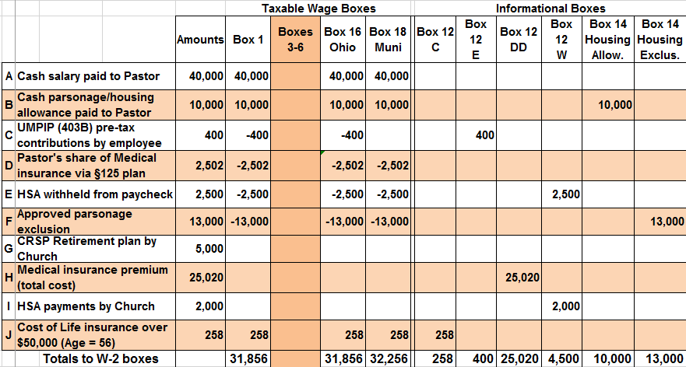
W-2 Worksheet
Boxes 3-6 of Form W-2 should always be BLANK for clergy. Clergy are self-employed for Medicare and Social Security.

Slide 4
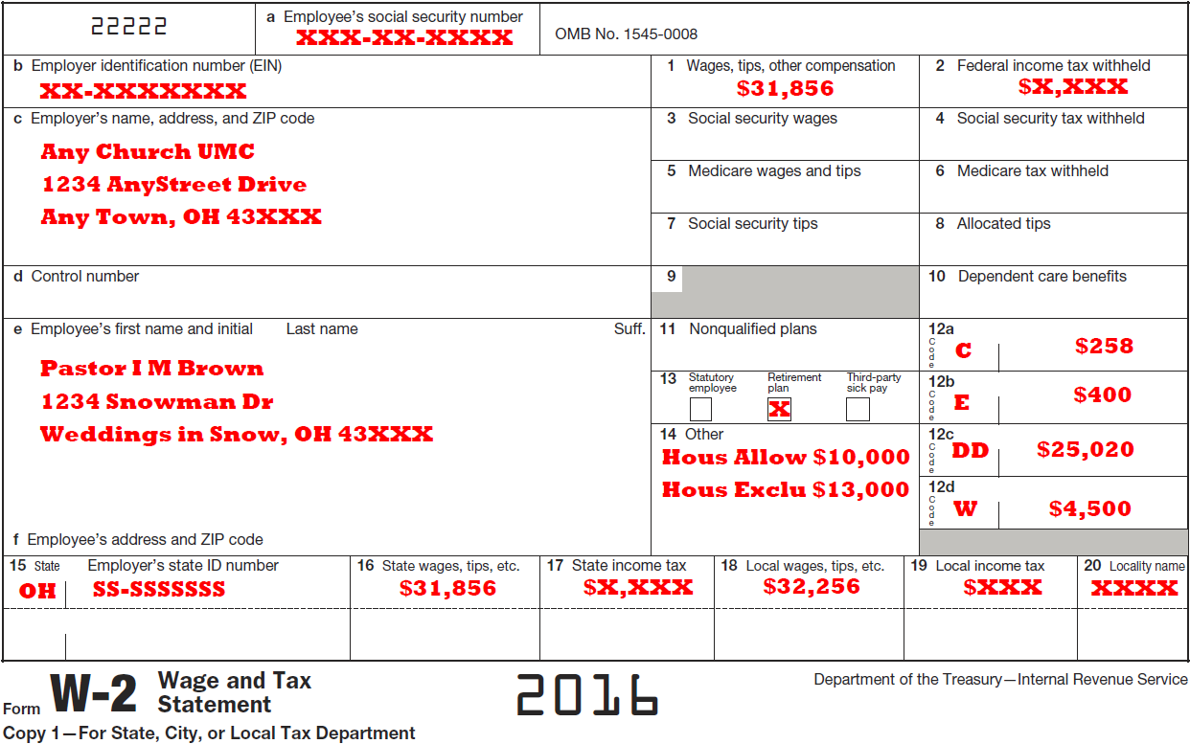
Example W-2
2018

